Slide 1

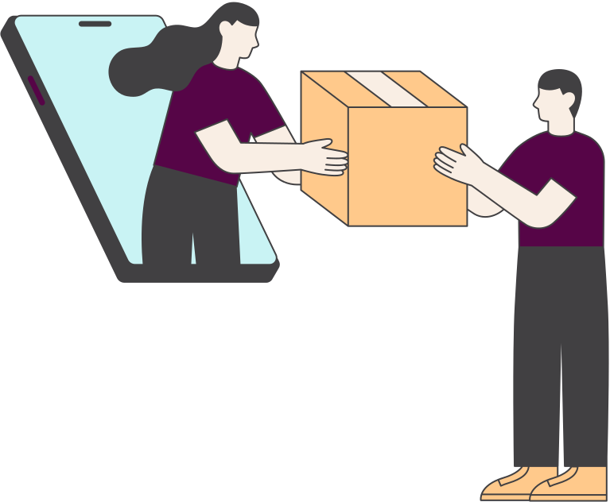


BUSINESS TRACK
REDUCING RTO: GETTING MORE ORDERS DELIVERED
PotentiallyBald
IIT (ISM) Dhanbad
Saket Kumar Singh
Mayank Raj
Sahil Bhavesh Choudhary

Slide 2



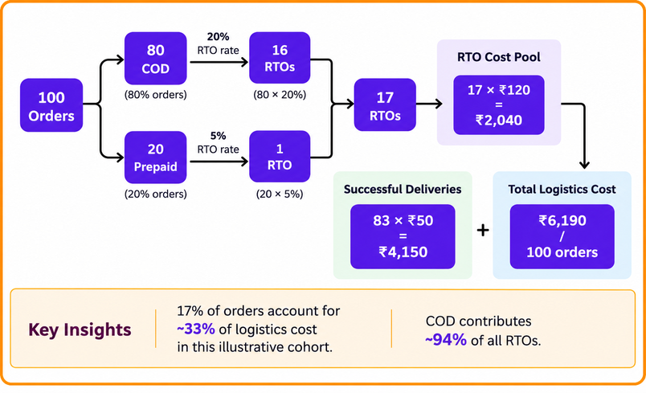
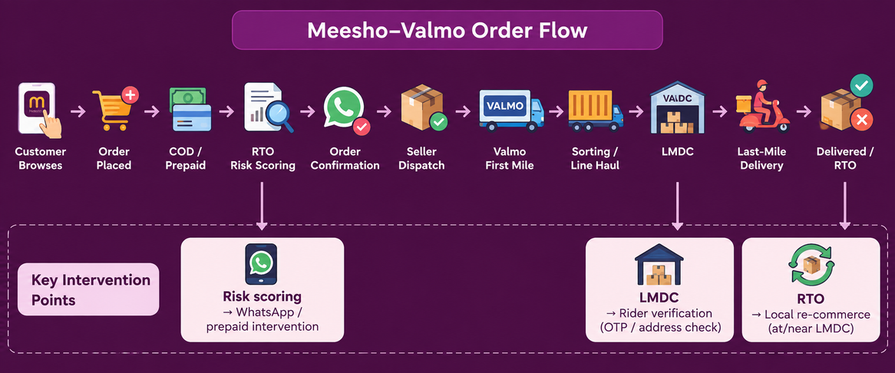
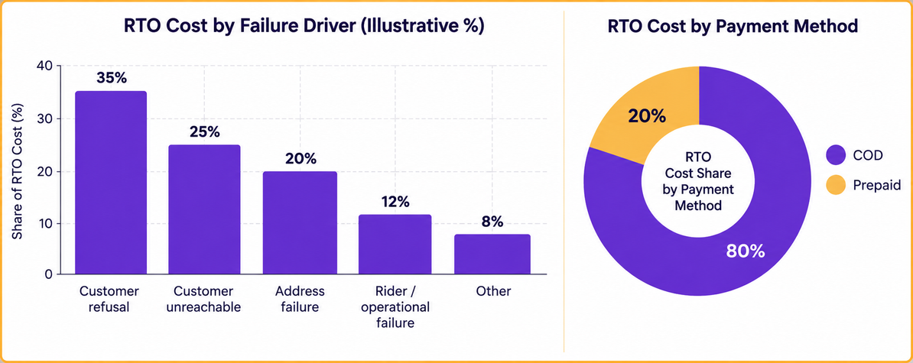
Problem Statement Redefined
Market Idea:
Objective
Challenges
Reduce RTO while preserving Meesho's COD-led growth and improving Valmo's last-mile economics.
  Customer Intent: COD dominates orders (80%); buyer remorse and temporary cash shortages contribute to delivery refusal.
  Last Mile Operations: Unstructured addresses and difficult locations increase RTO; deliveries >10 km from LMDC reach 22% RTO.
  Rider Incentives: Low payout (~₹21/delivery) can create incentive misalignment for high-effort deliveries and potential fake attempts.
  Reverse Logistics: RTO costs ₹120 vs ₹50 for successful delivery ; a 2.4× cost asymmetry that significantly impacts margins.
Potential Opportunity
  Convert RTO from a pure cost centre into a controllable operational metrics
  94% of RTOs come from COD in the case baseline
  Risk based prepaid conversion can reduce expected RTO cost
  Rider proof of attempt can reduce operationally induced RTO
  Local RTO interception can avoid unnecessary reverse transportation
  Valmo's decentralized LMDC network creates an opportunity for local resale
RTO Failure Driver (%)
Payment Method (%)

Slide 3
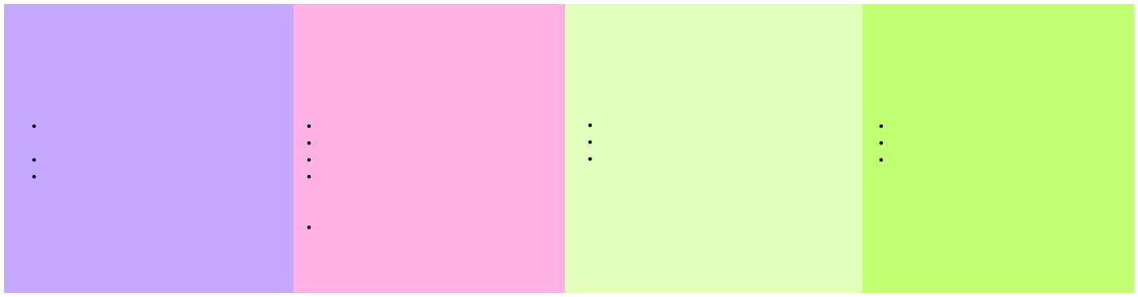
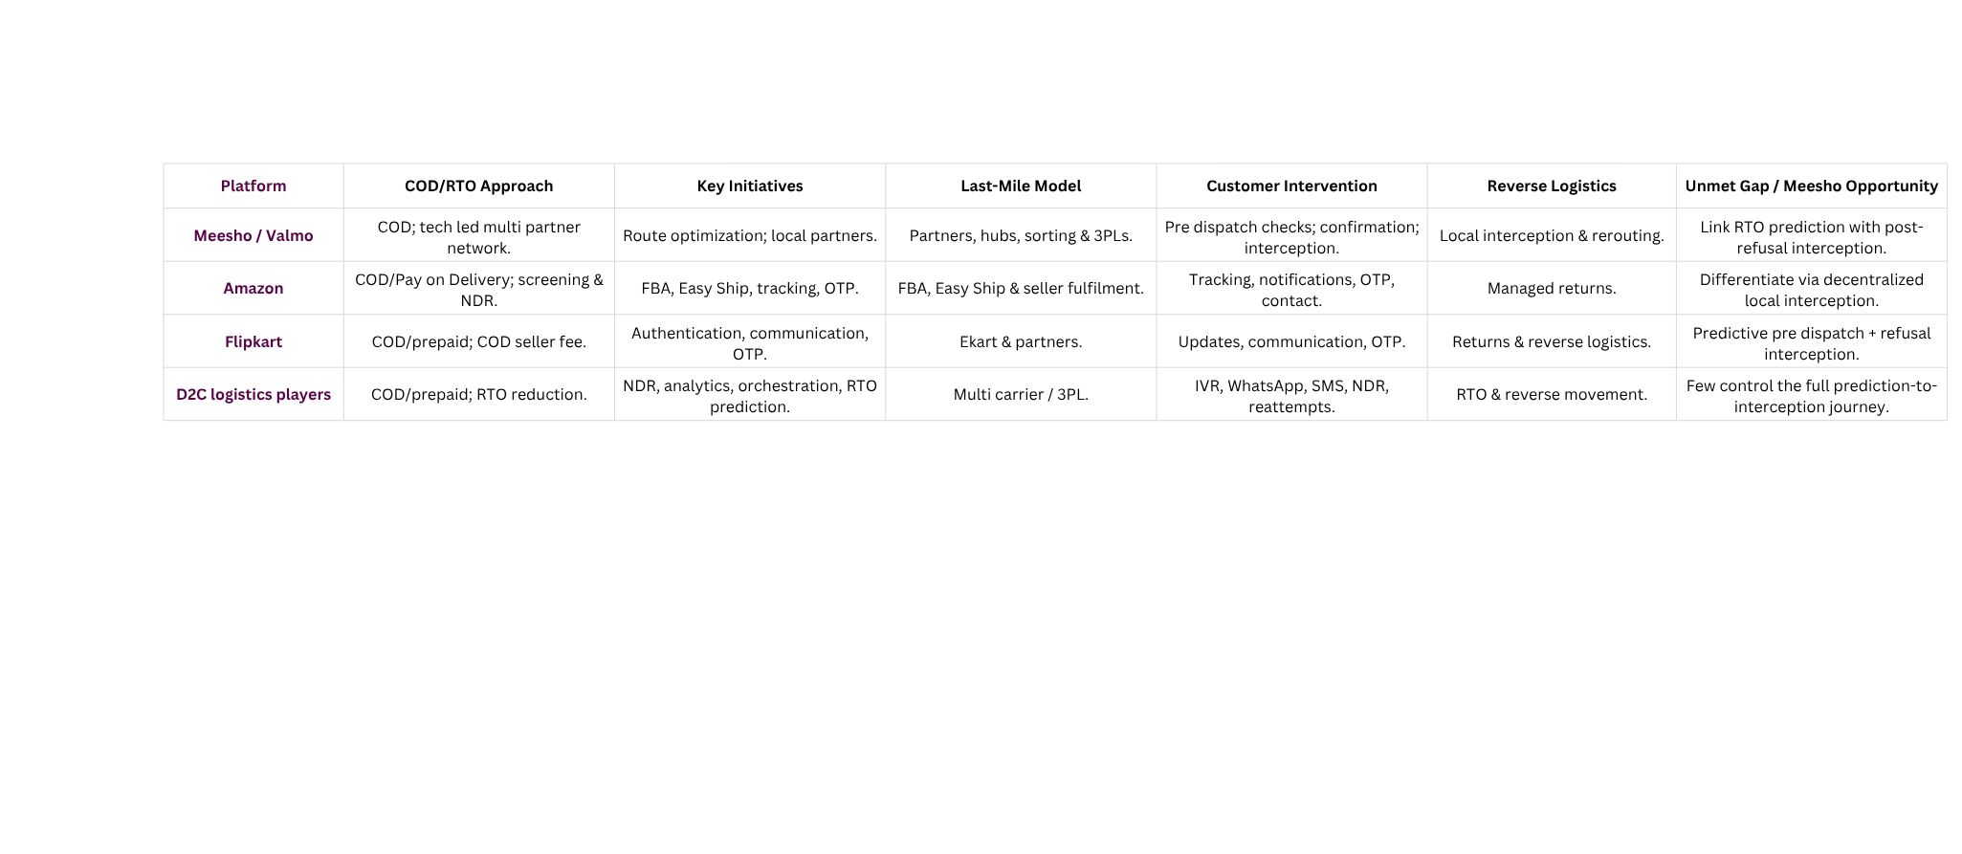
Problem Statement Redefined
Delivery Stakeholder Personas
Market Sizing
1. Last-Mile Rider
Profile: Valmo delivery partner serving an LMDC.
Goals: Maximize earnings, complete deliveries efficiently, minimize travel/time.
Pain Points:
• Long distance routes
• Unstructured addresses
• Customer unavailable
• Low reward relative to effort
Digital Maturity: High
Opportunity for Meesho: GPS proof of attempt + route optimization + differentiated incentives for difficult deliveries.
2. COD Customer
Profile: First-time / infrequent Meesho customer choosing COD.
Goals: Convenience, no upfront payment, easy returns.
Pain Points:
• Buyer remorse
• Cash unavailable at delivery
• Doesn't want to wait 3–5 days
• Address/location ambiguity
Digital Maturity: High
Opportunity for Meesho: Targeted prepaid incentive + WhatsApp confirmation + live location sharing.
3. LMDC / Hub Operator
Profile: Local logistics node handling shipment sorting and last mile allocation.
Goals: High throughput, low RTO, efficient rider utilization.
Pain Points:
• Poor address quality
• Rider capacity mismatch
• High failed-attempt volumes
• RTO inventory accumulation
Digital Maturity: High
Opportunity for Meesho: RTO heatmaps + rider analytics + local recommerce inventory matching.
4. Seller / Merchant
Profile: Merchant whose product gets returned.
Goals: Successful delivery, minimize inventory loss, protect margins.
Pain Points:
• ₹120 RTO hit
• Restocking cost
• Packaging damage
• Inventory tied up during reverse journey
Digital Maturity: Moderate to High
Opportunity for Meesho: Local RTO interception + faster inventory recovery + merchant visibility.
Competitive Benchmarking

Slide 4




Models to Reduce RTO & Recover Delivery Value
MODEL 1 — RTO RISK ENGINE + PRE-DISPATCH INTERVENTION
Model 2 – RTO Interception + Local Re-commerce
What it is
A real-time model predicts the RTO probability of every COD order and triggers the cheapest effective intervention based on the risk level.
What it is:
Instead of automatically sending refused shipments back through the reverse network, eligible products remain at
the destination LMDC and are matched with nearby demand.
Execution Flow:
  Order placed → COD order enters the RTO risk engine.
  RTO risk score generated using customer, order, address and historical delivery signals.
  Low risk → Normal COD journey.
  Medium risk → WhatsApp confirmation + address/location verification.
  High risk → ₹15 prepaid incentive / mandatory order confirmation.
  Confirmed order → Seller dispatch → Valmo delivery.
  Failed intervention → Order held/cancelled, avoiding an unnecessary ₹120 RTO cost.
Execution Flow:
  Customer refuses delivery.
  Shipment reaches the destination LMDC.
  Product eligibility and condition check.
  Nearby customer demand identified.
  Match found → Offer targeted 15–20% discount.
  Product delivered to a new nearby customer.
  No match → Proceed with normal RTO.
Benefits:
  Targets high risk COD orders instead of adding friction to all customers.
  Converts selected COD orders to prepaid, reducing RTO exposure.
  Improves address quality and first attempt delivery success.
  Preserves COD accessibility for reliable customers.
  Makes interventions economically viable by comparing ₹15 intervention cost vs. ₹120 expected RTO loss.
Benefits:
  Eliminates unnecessary reverse line haul.
  Reduces inventory transit and handling.
  Recovers value from refused shipments.
  Converts RTO inventory into local inventory.
  Potentially reduces the ₹120 RTO cost.
Bottlenecks and Solutions:
  False positives → Continuously track intervention conversion, cancellations and customer complaints.
  ₹15 incentive economics → Trigger only when expected RTO loss > intervention cost.
  Customer friction → Use single click WhatsApp confirmation with minimal additional steps.
  Model bias / cold start → Retrain using actual RTO outcomes and use broader order/address signals where customer history is limited.
  Intervention failure → Escalate only high-risk orders to stronger confirmation or prepaid conversion.
Bottlenecks and Solutions:
  Product damaged/opened → Eligibility inspection before relisting.
  No local demand → Route the shipment through the normal RTO process.
  Merchant doesn't want resale → Make local recommerce merchant opt in.
  Customer distrust → Maintain Meesho's existing quality and review layer.
  Inventory mismatch → Use local demand prediction + SKU matching.
Critical Thinking & Fit
Preventive Layer: Model 1 reduces RTO through targeted pre dispatch intervention.
Recovery Layer: Model 2 reduces the economic impact of unavoidable RTO through local recommerce.
Strategic Fit: Both leverage COD data, Valmo's LMDC network, WhatsApp, and local delivery infrastructure.
KPIs for Success
Model 1 → RTO ↓ • COD→Prepaid • Confirm % • 1st-attempt delivery % • RTO cost avoided • Net savings/order
Model 2 → RTO intercepted % • Re-commerce % • Recovery/RTO • Reverse cost avoided • Delivery success % • Net savings/RTO

